Slide 1
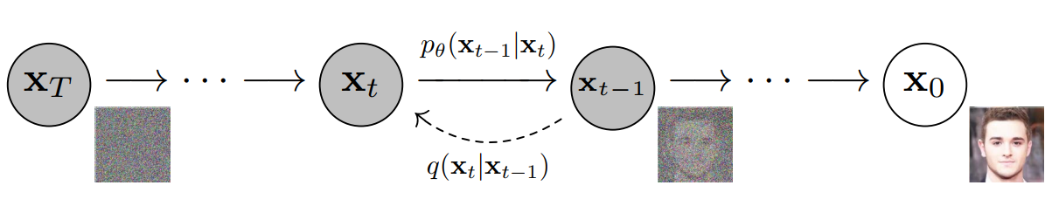
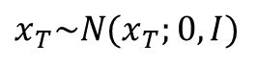
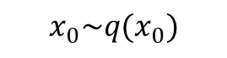



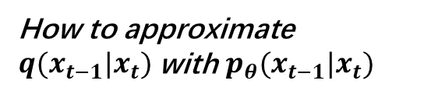
Denoising Diffusion Probabilistic Models
Forward/Diffusion Process (Adding Noise by $q(x_{t}|x_{t−1})$)
$$x_{T}\sim N(x_{T};0,I)$$
$$x_{0}\sim q(x_{0})$$
How to approximate $q{(x}_{t−1}|x_{t})$ with $p_{θ}(x_{t−1}|x_{t})$
$$q{(x}_{t−1}|x_{t})$$
not identifiable
Reverse Process(Denoising with $p_{θ}$)

Slide 2
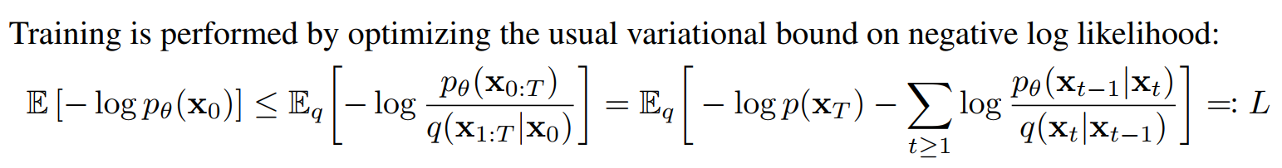
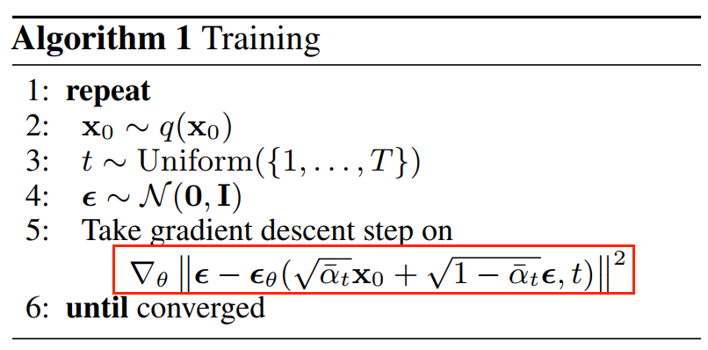
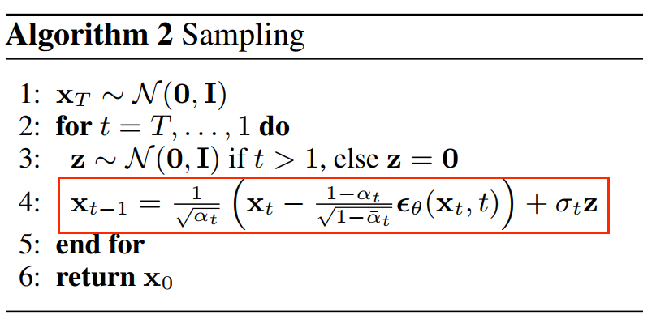
?
?

Slide 3
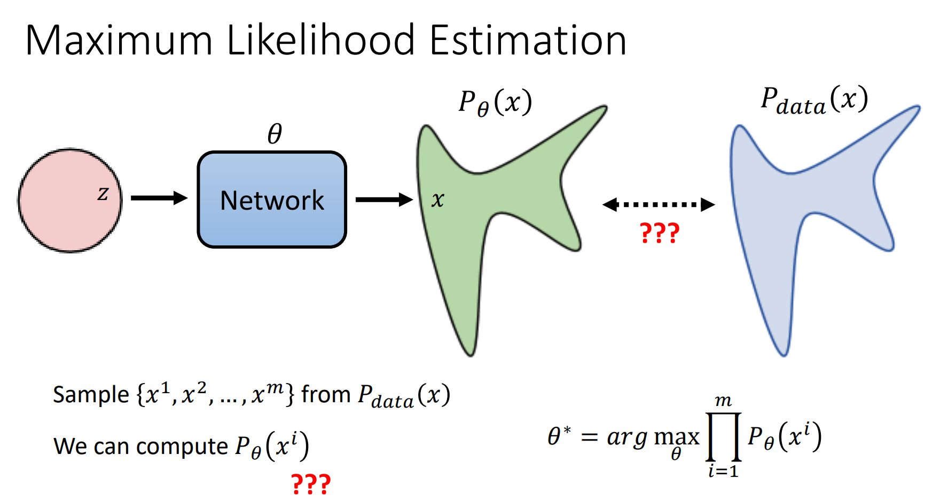
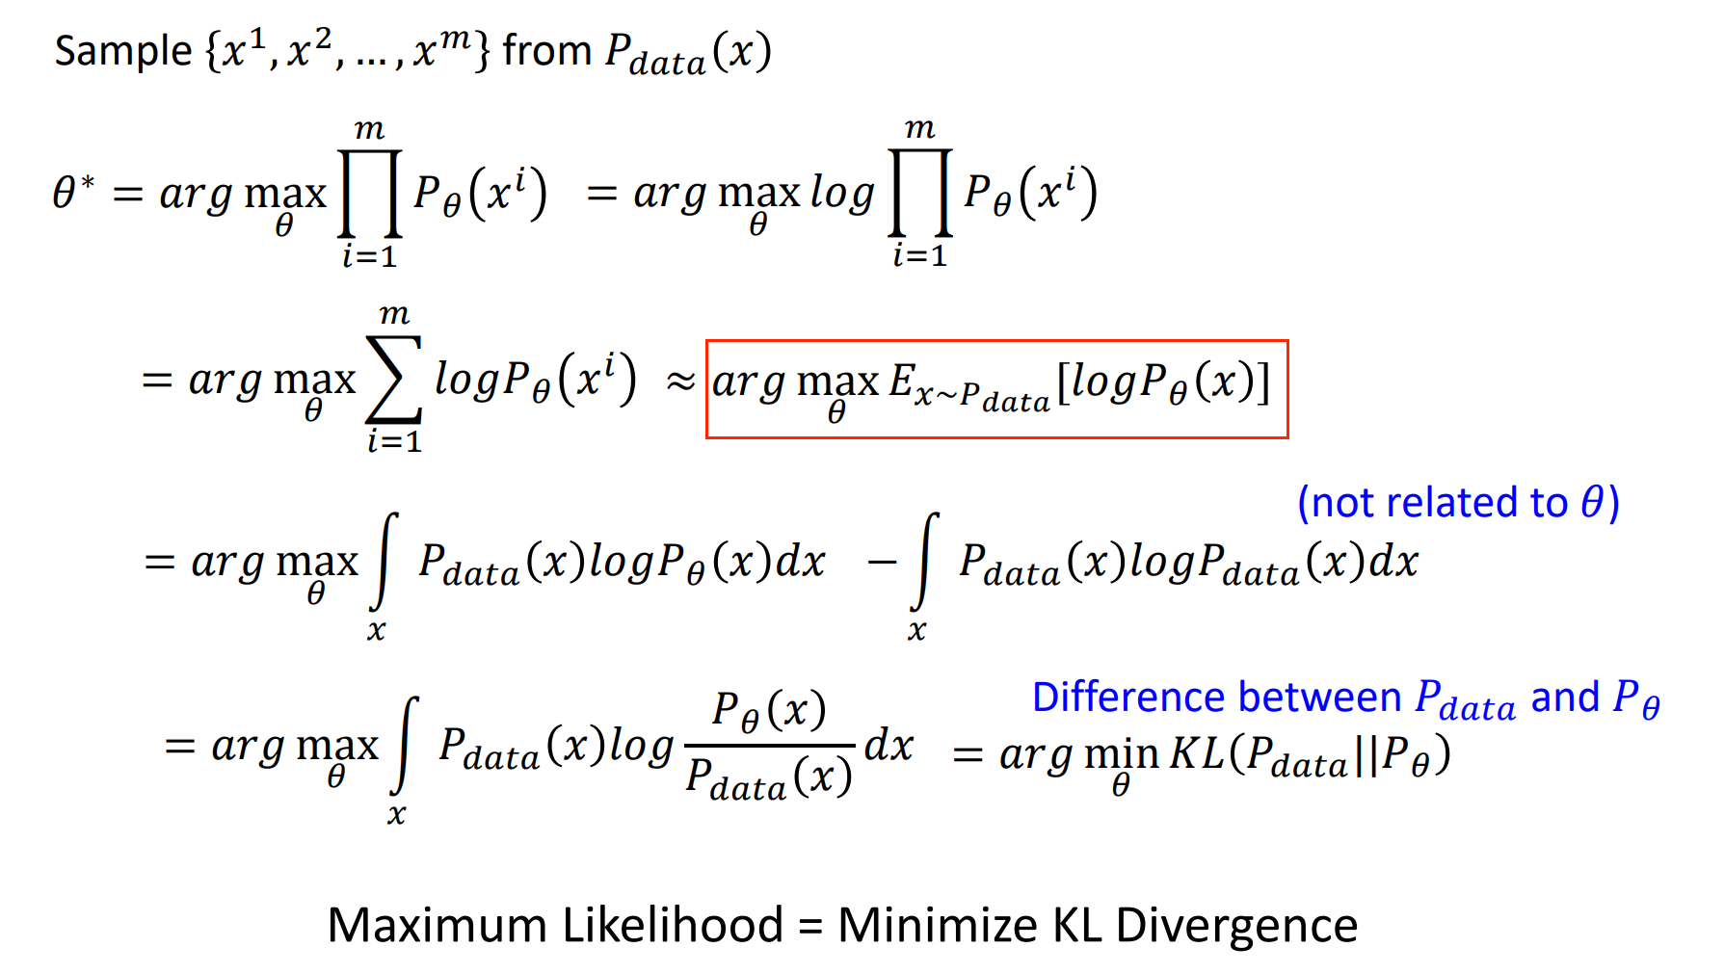
Slides from Machine Learning(2023 Spring)---Hung-yi Lee

Slide 4
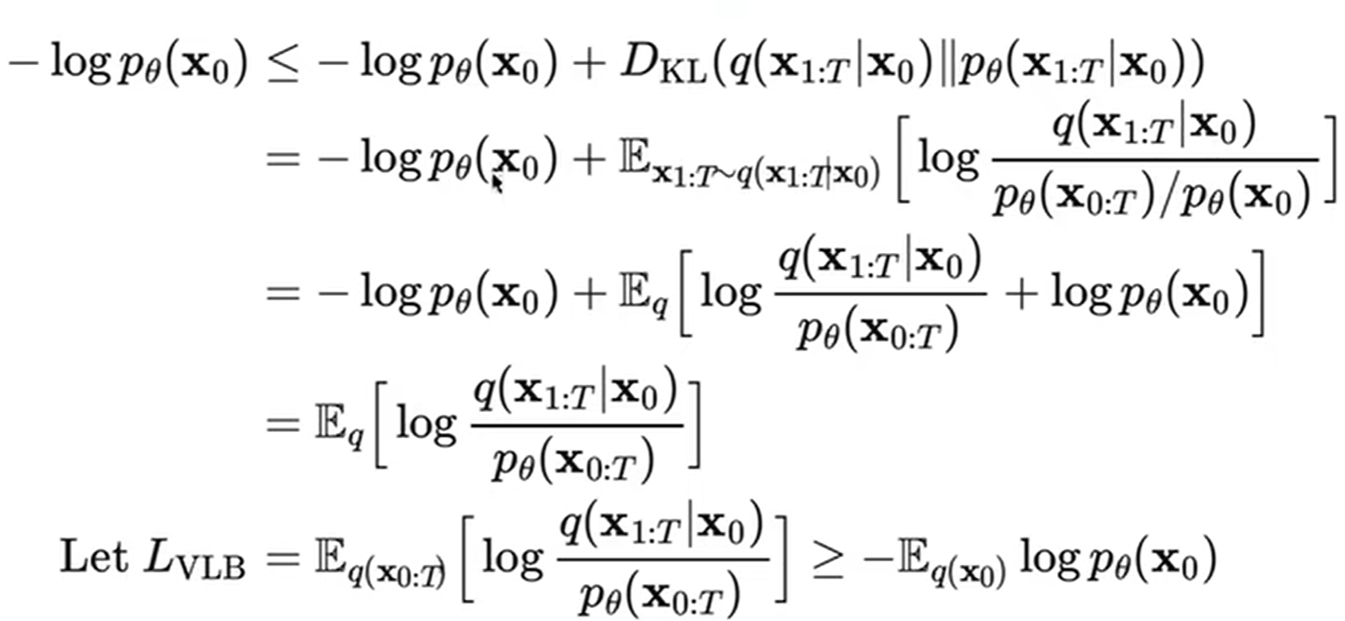
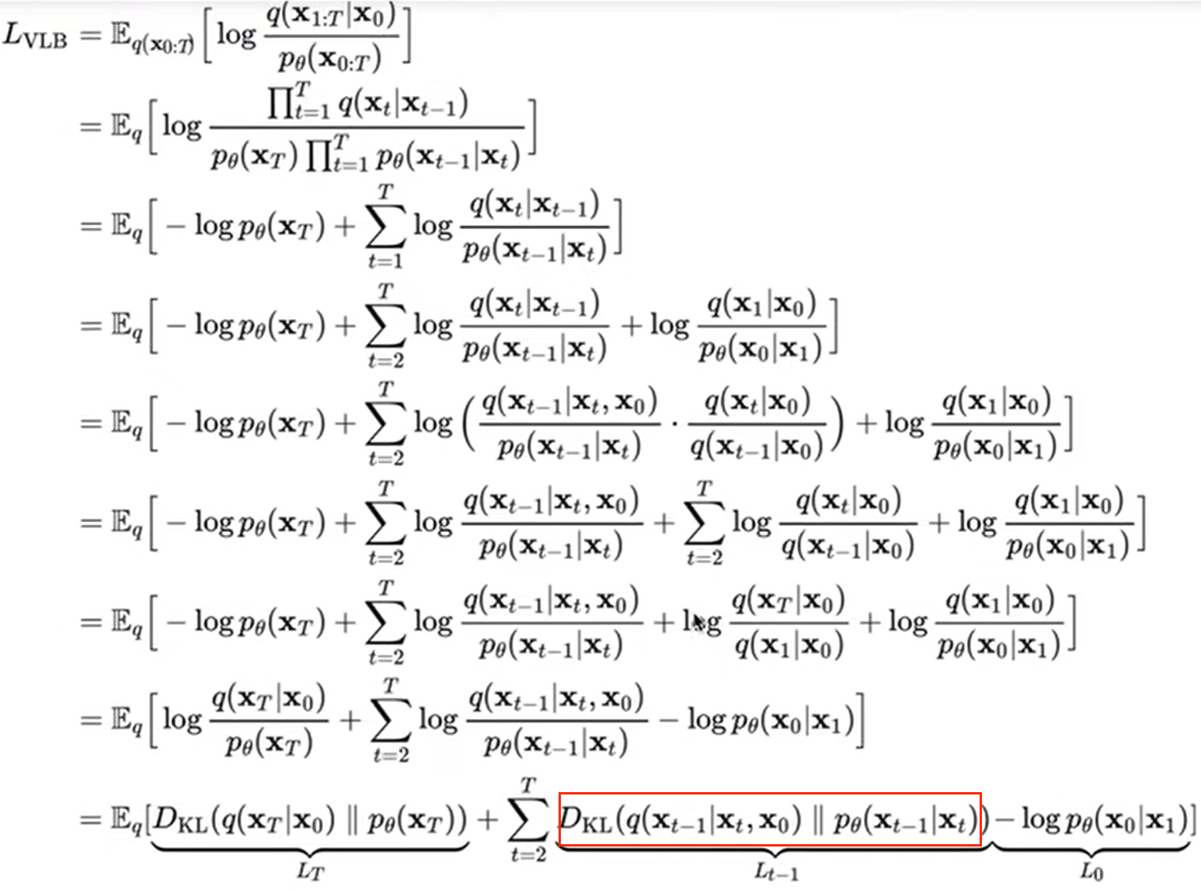
https://www.bilibili.com/video/BV1b541197HX/?vd_source=0cb0e9cbbb8a9bfd7e423504b1bb4d81

Slide 5
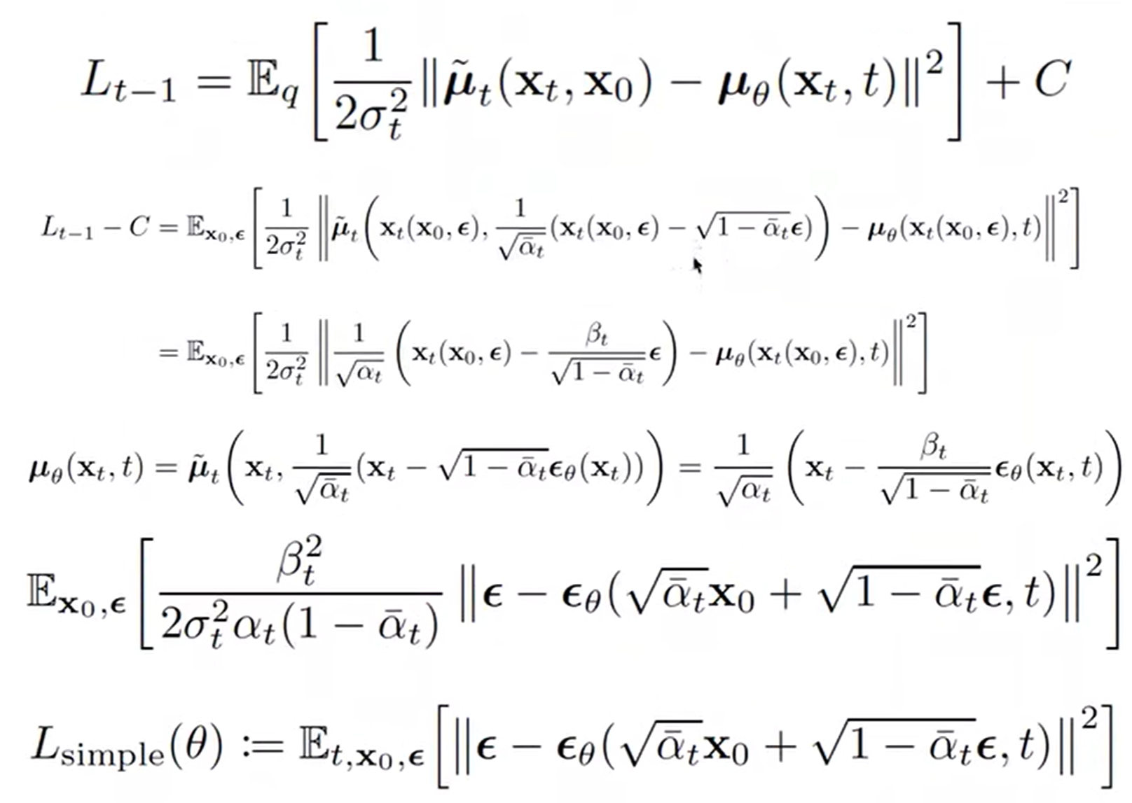
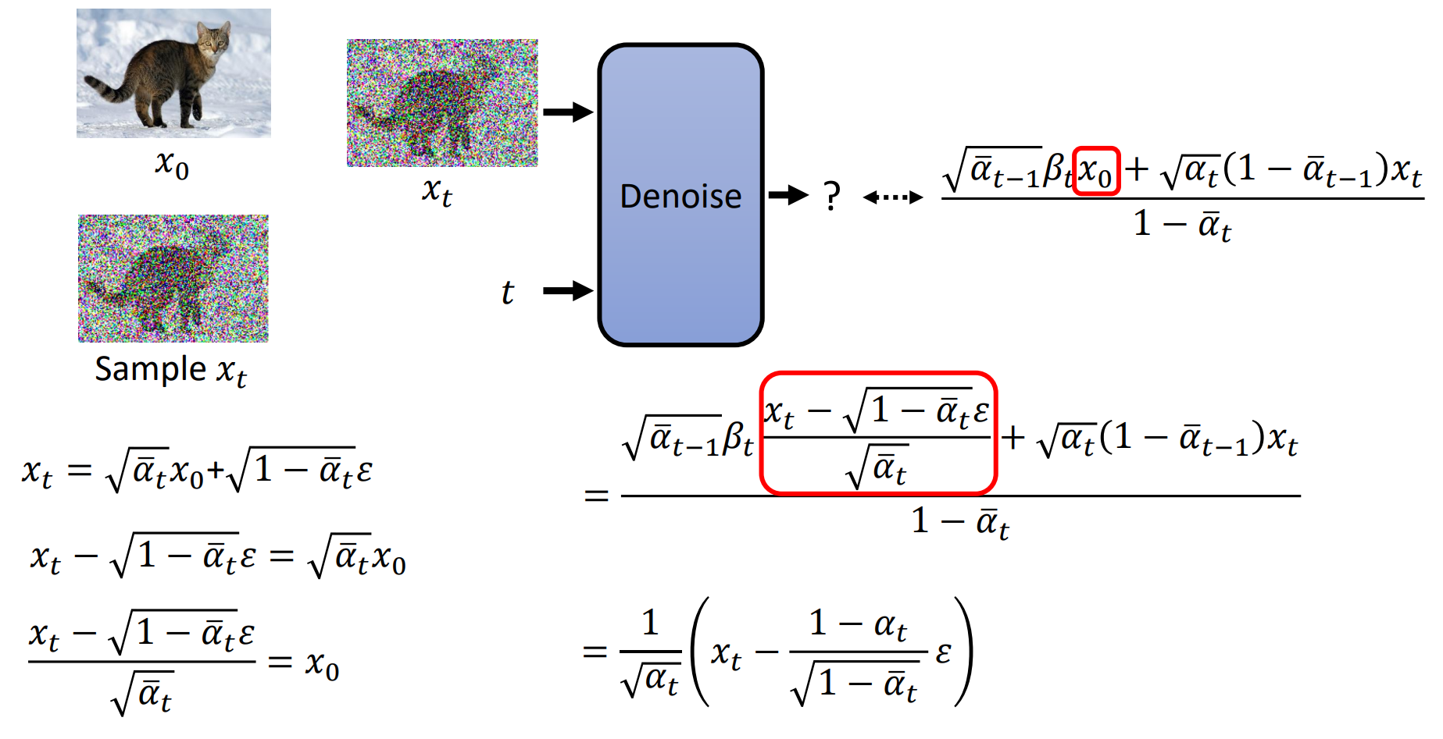
https://www.bilibili.com/video/BV1b541197HX/?vd_source=0cb0e9cbbb8a9bfd7e423504b1bb4d81
Slides from Machine Learning(2023 Spring)---Hung-yi Lee

Slide 6
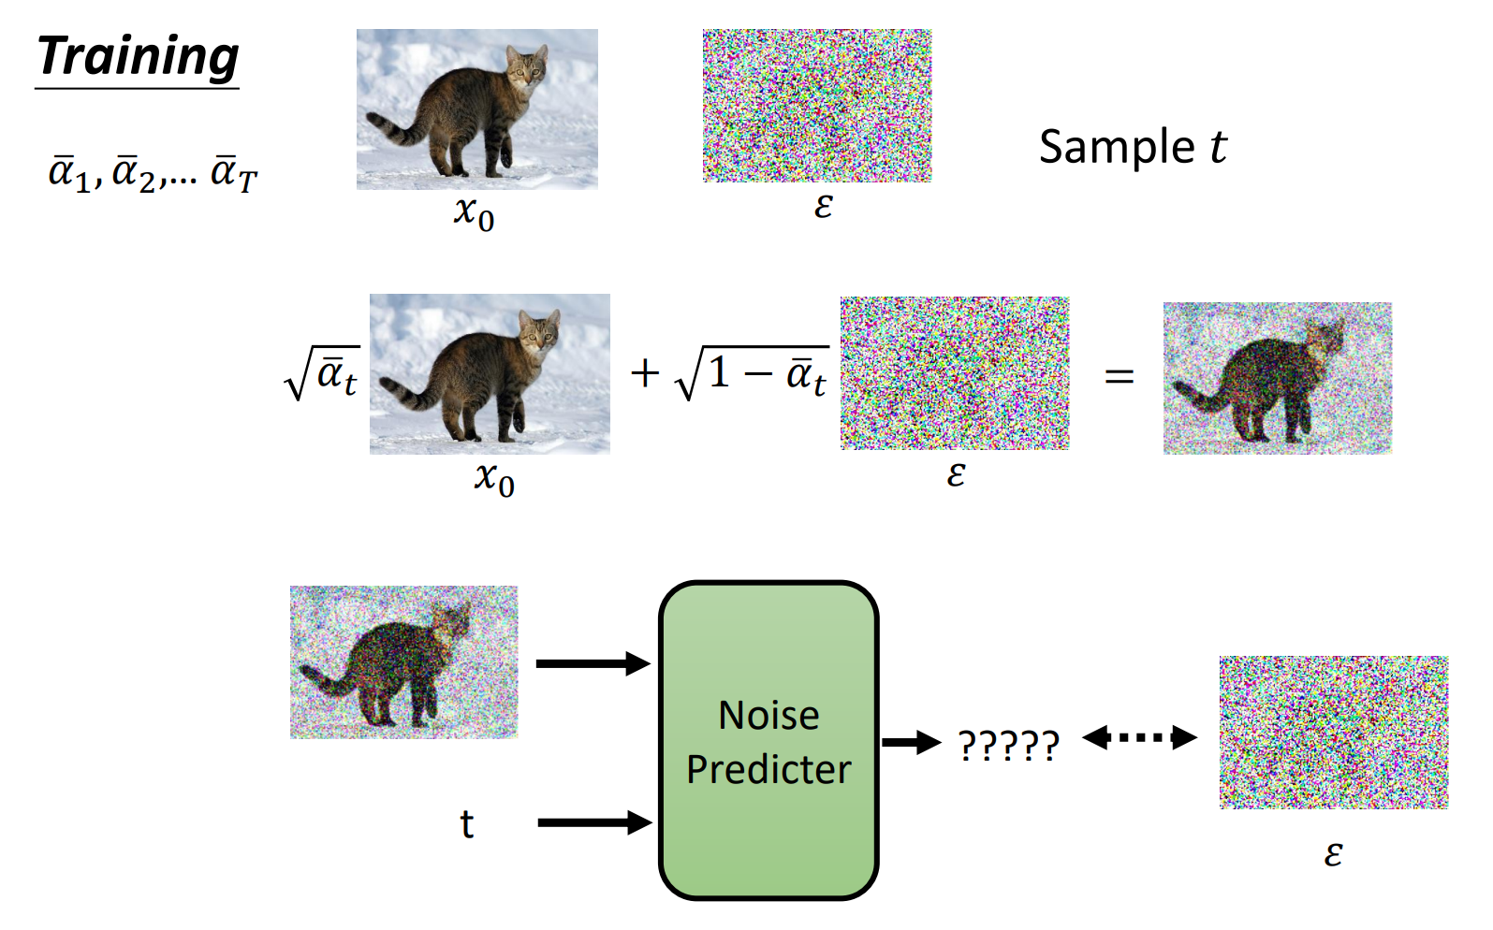
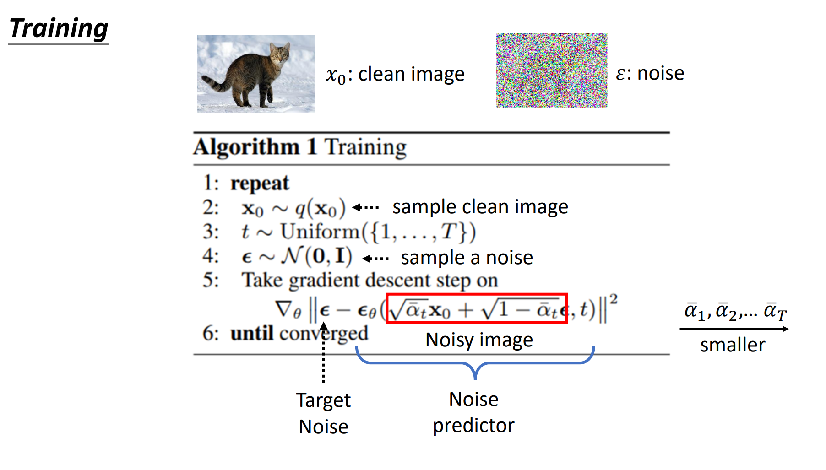
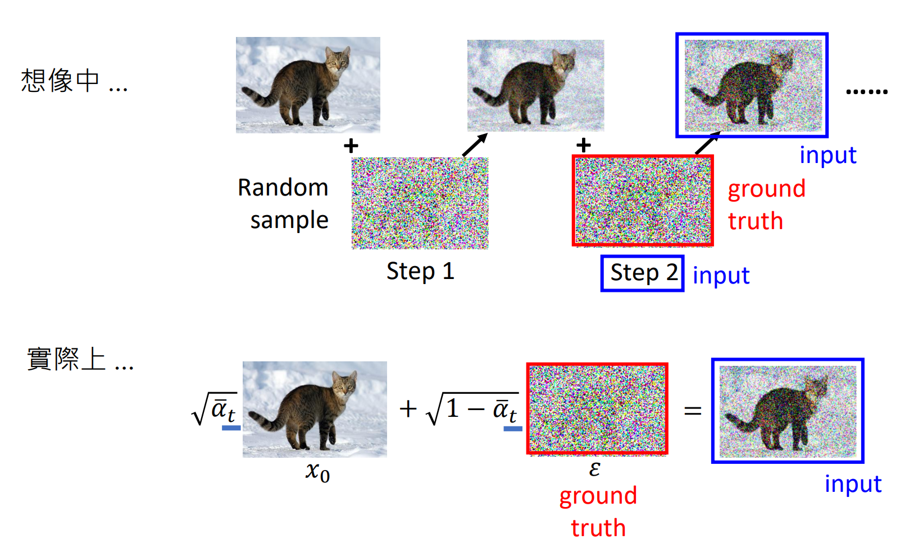
How DDPM works
Slides from Machine Learning(2023 Spring)---Hung-yi Lee

Slide 7
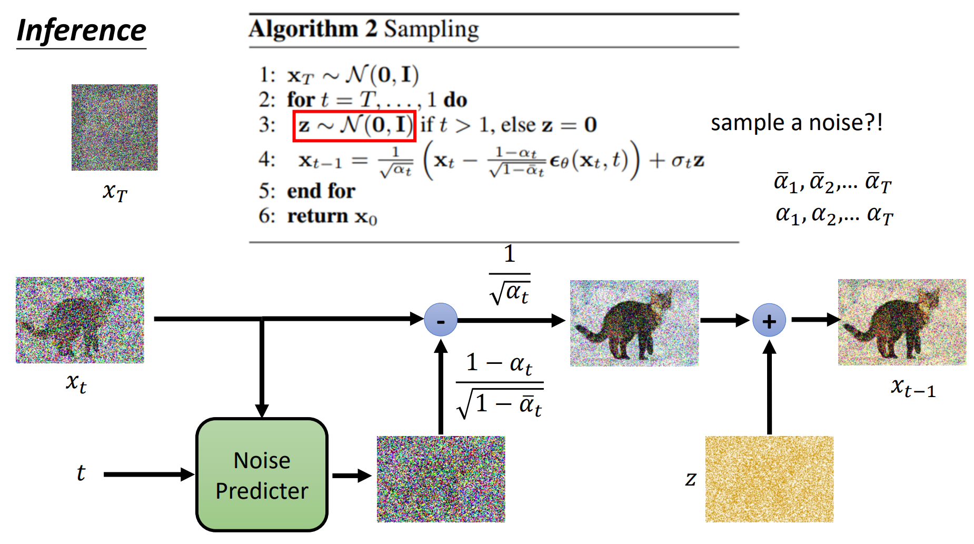
Slides from Machine Learning(2023 Spring)---Hung-yi Lee

Slide 8
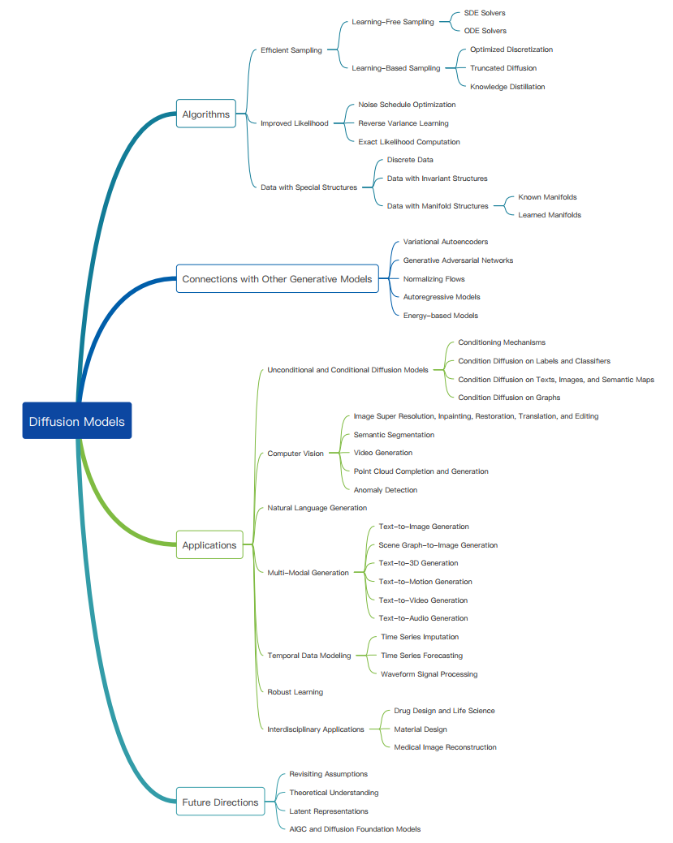
Yang, Ling, et al. "Diffusion models: A comprehensive survey of methods and applications." ACM Computing Surveys (2022).

